Slide 1
ARGO Project
By Axel Amzallag, Tim Kalnins, and Joshua Hug

Slide 2
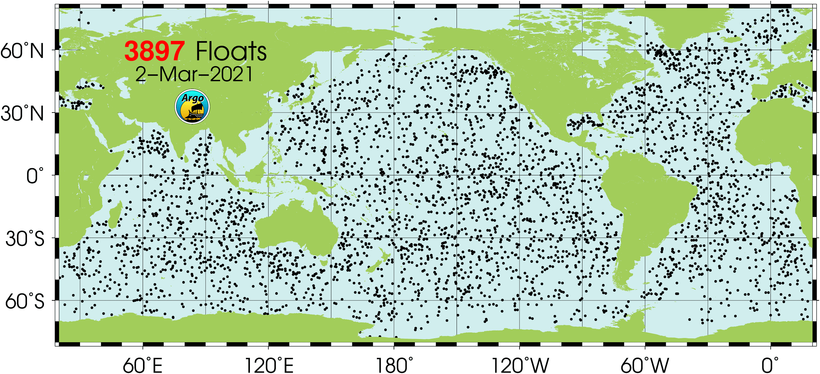
ARGO: Refresher on Basics
ARGO is a system of buoys that go down into ocean and measure temperature, salinity, and other variables of ocean water. They are found all over the globe.
The buoys are down for ~10 days, and can drift up to 100 kilometers on each dive.
After their drift, buoys begin an ascent, during the ascent measurements such as temperature, pressure (a proxy for depth), and salinity are taken
After the ascent the buoys surface and relay all of the data via satellite before beginning the cycle again

Slide 3
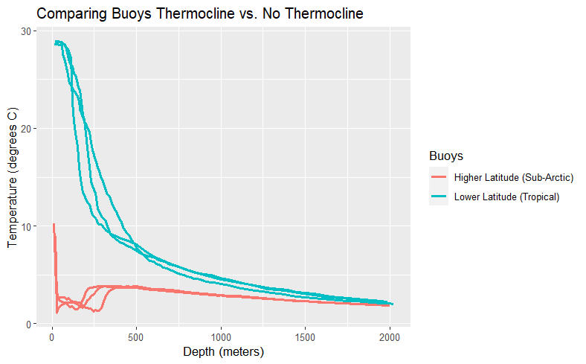
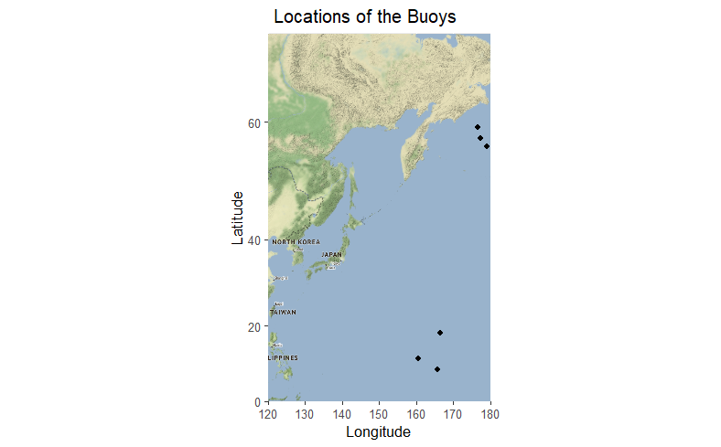
Thermocline Intro (August 2010 Data)
Thermocline: Steep drop in temperature over (relatively) small change in depth.
Clear Thermocline in the Teal Buoys: The surface temperature drops in a steep descent from surface level to the deep level.
No Thermocline in the Red Buoys: Surface temperature is similar to deep temperature.

Slide 4
Our Current Goal: Typhoons & Thermocline Depth
We want to see if there is a relationship between the depth of thermocline and the starting location of typhoons in Pacific.
Hypothesis: Deeper thermoclines have higher likelihood of starting typhoons because there is more warm water.
Control: Latitude and longitude with no other input variables.
Goal is a model that outputs the areas of the ocean where typhoons are most likely to start.
Want to add Surface Temperature as a covariate or confounding variable.
Surface Temperature is a relatively simple statistic to make.
Current model doesn’t include it, but should be easy to fold into future improvements.

Slide 5
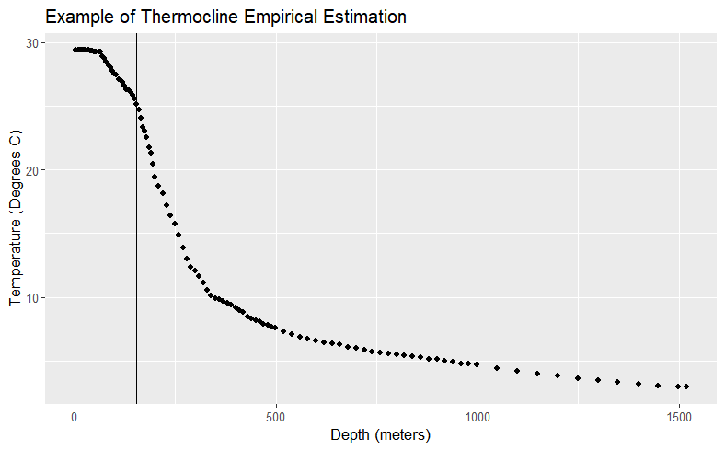
Thermocline Depth: Creating a Statistic
Challenge: Thermoclines don’t consistently start the same way.
In the top layer of water (called the epipelagic zone), temperature is sometimes flat, sometimes descending.
Bottom of the epipelagic layer is not always the beginning of the thermocline. Earliest/steepest drop in temperature not necessarily correct.
Debate on best practices for empirically measuring the thermocline are ongoing.
For our project, used variable representative isotherm: a method created by Wang et. al (2000), modified, and empirically tested by Fiedler (2010).
Note: Method on next slide.

Slide 6
Variable Representative Isotherm
TT: Thermocline Temperature
T(MLD): Temperature of Mixed Layer Depth (defined as Surface Temp. - 0.8)
T(400m): Temperature at depth of 400 meters
For each buoy, choose the depth measurement where temperature is closest to TT as thermocline depth for given (Lat, Long) location.
Strength: This method, when compared empirically by Fiedler, accurately predicted thermocline start depth better than other methods, including methods that used gradients and inflection points. Root Mean Squared Error (RMSE) is ~10 meters, while other tested methods had RMSE values around 20 meters.
Weakness: If the buoy doesn’t have a thermocline, you get junk results.
Weakness: Not tested on latitudes above 40 degrees with surface temperatures below 10 degrees Celsius. On our data, these produced terrible outputs.
Weaknesses shouldn’t affect our project: we are focused on warm, equatorial waters.

Slide 7
Answering the Question
We have sparse spatial point data about the thermocline depth via the variable representation isotherm
How to relate this via a model to typhoon data?
Thermocline Depth
A model that gives us the thermocline depth at any point in the ocean from empirical measurements.
Typhoon beginning
A model that using the thermocline depth at any point informs us about probability of typhoon originating at/near that point

Slide 8
Thermocline Depth approach 1: Modeling the entire thermocline directly
Our first approach was to model the entire thermocline, essentially modeling
Therefore this model takes in a fixed Latitude, Longitude pair and then we vary the pressure to simulate a buoy’s dives measurements.
Many models of this form were fit all yielding similar results.
A concern with a model of this form is that it is difficult to find the thermocline depth given a predicted thermocline since there is often not a noticeable change in depth.

Slide 9
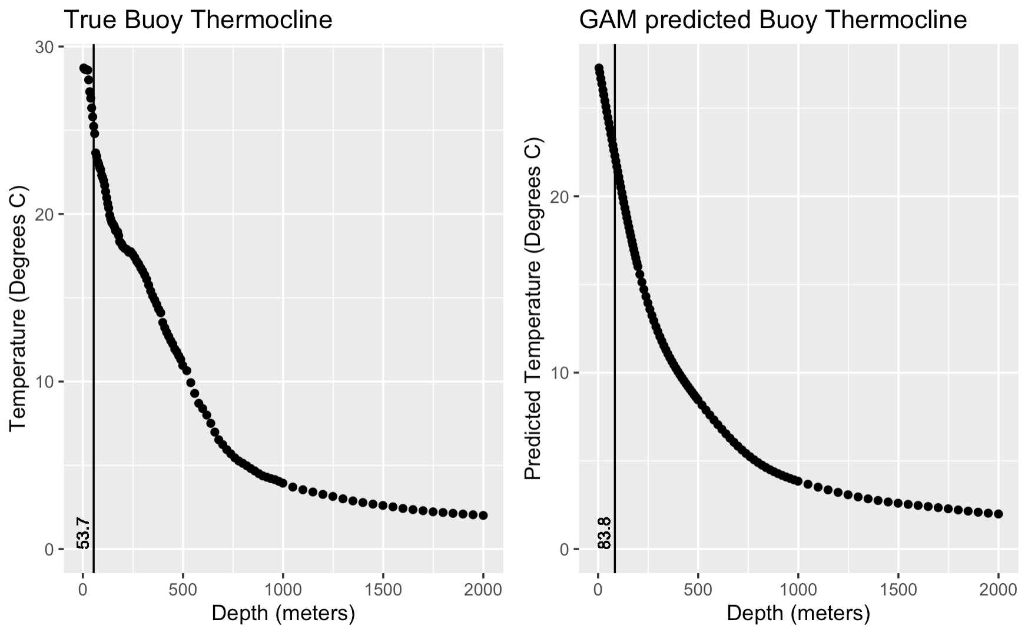

Slide 10
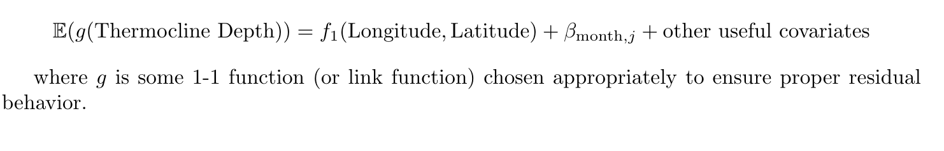
Thermocline Depth approach 2: Get rid of one dimension
Predict the thermocline depth directly rather than modeling the entire thermocline
Label the thermocline depth at (Longitude, Latitude) via variable representative isotherm for buoys that we have, build a model that predicts the thermocline depth at any Longitude and Latitude for a specific time frame.
This significantly reduces the model complexity, since all the dive data is reduced to a single data point for a specific longitude and latitude coordinate

Slide 11
Intro to Generalized Additive Models (GAMs)
The previous 2 models were both fit with Generalized Additive Models (GAMs) from the mgcv R package
GAMs are an extension of generalized linear mixed models to model more complex nonlinear relationships.
The general form of a GAM is as follows:
This is a sum of smooth functions, in mgcv each function is a penalized spline of some sort.
Therefore there is considerable flexibility in the spline basis used, the number of basis elements and the smoothness of the output
Notes:
Talk about how random effects and basic linear models are special case

Slide 12
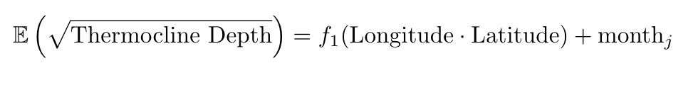
Using GAMs to Model Thermocline Depth
The base form of the current model we are fitting to predict thermocline depth:
This is the simplest form of the model and more complicated forms of the model include as predictors additional random effects, an estimate of the surface temperature, as well as Latitude not as an interaction term.
In experimenting with different spline bases, we are looking at splines on a sphere due to spatial data, as well as the Gaussian process (kriging) splines
Currently our method gives a root MSE of about 20 meters.

Slide 13
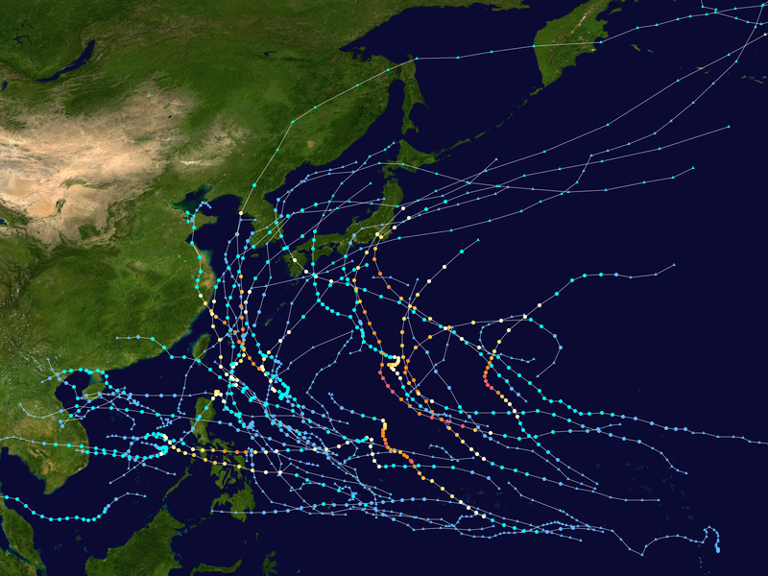
Typhoons & You
Pacific typhoon season is between May and November peaking in August and September
Thermocline depth and typhoons are intertwined: the depth of the thermocline can indicate the risk of a cyclone forming.
The Navy’s meteorological/oceanographic command (CNMOC) keeps detailed records of every typhoon in the northwestern Pacific region dating back to 1945
2019 Pacific typhoon season

Slide 14
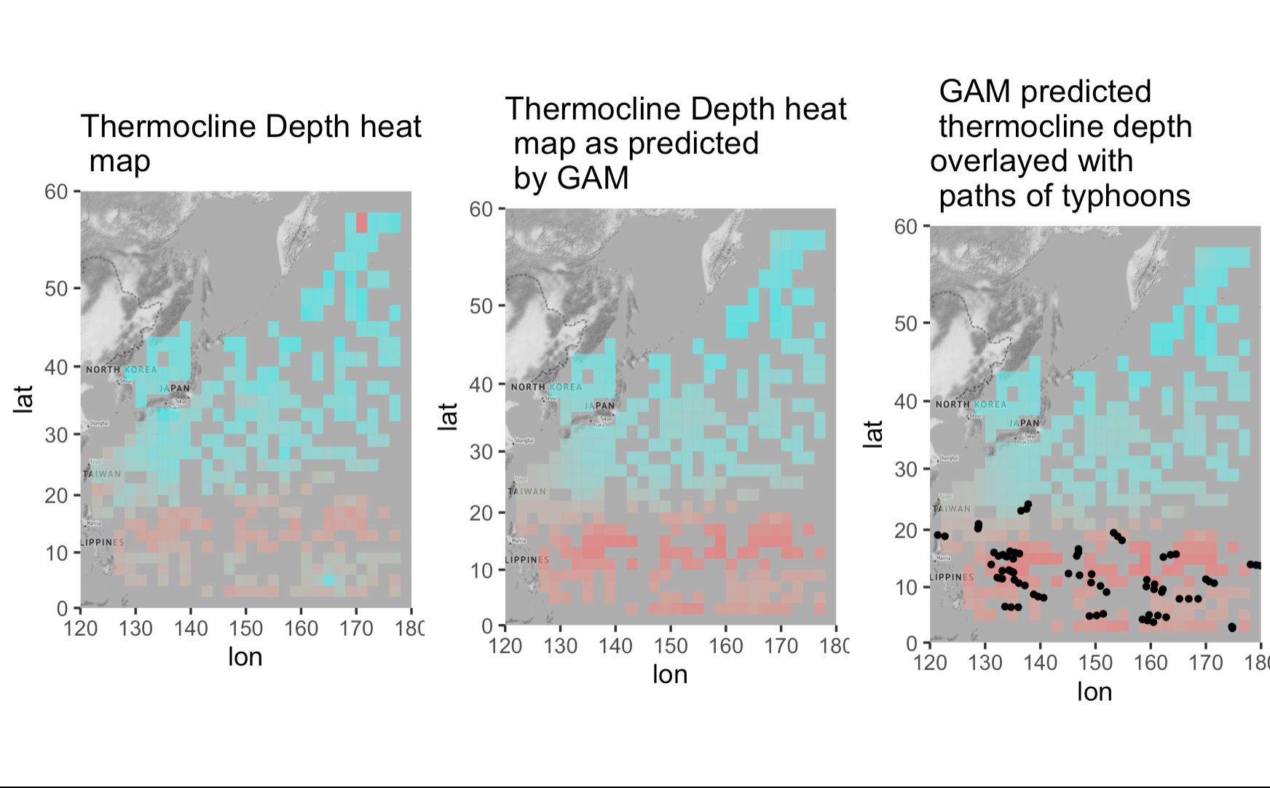
Our Future Plans & a Second Model

